Slide 1
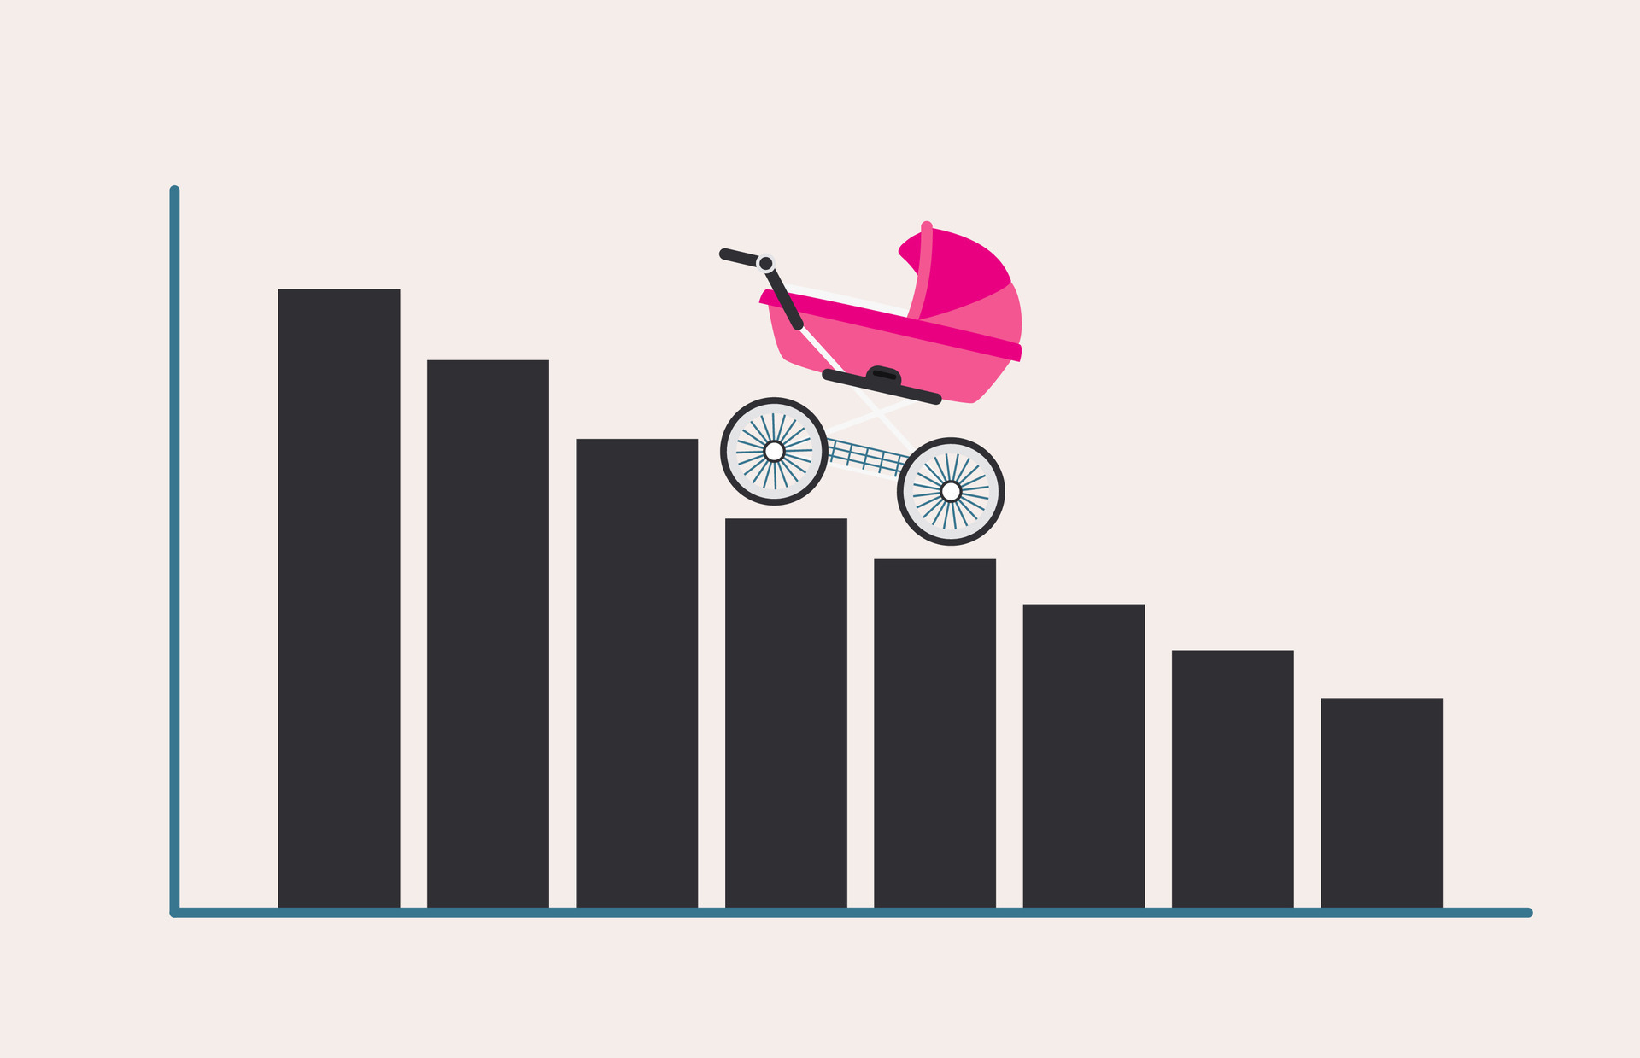
Birth Rate Analysis
The Story of the Collapse of a Nation.
GROUP 6:
Priscilla Morales, Josephine Robideau, Elphys Alvarez, Michael Cox, Eric Stewart-Alicea.

Slide 2







Why do we care?
Interest and Worry in the U.S. Birth Rate has increased Overtime without any improvement.
Definition: Crude birth rate indicates the number of live births occurring during the year, per 1,000 population estimated at midyear.
We need the youth to contribute to Social Security Benefits.
The youth contributes more to GDP than retired individuals.
We need to stay competitive with other nations.
Our goal is to identify variables that may have affected birth rate over the past 40 - 50 years.

Slide 3
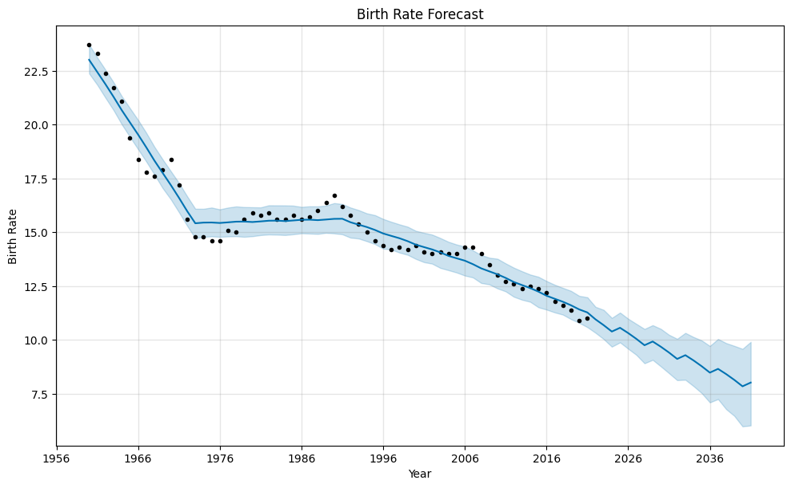
Prophet Analysis - Birth Rate Forecast
Analysis run using prophet module to forecast birth rate for the next 20 years, 2020 - 2040.
2019: 11.4 rate
2040: 8.0 rate
Birth rate is predicted to continue to decline.

Slide 4




METHODOLOGY:
DATA COLLECTION & RESEARCH DESIGN
Data Collection
Our Approach
Research Design
Fred - Federal Reserve Bank of St. Louis.
Median Income (25-34 year old)
Median Income / Med Annual Home Sale Price.
Consumer Sentiment
Inflation
GDP
Individually looking for different variables we thought could affect birth rate and independently running analysis on birth rate and our chosen variables.
Exploratory Analysis Using Python and Pandas
Statistical Analysis - Correlations
Prophet Analysis: Forecast Birth Rate for the next few years
Data.oecd.org
GDP/Family GOV Spending
OurWorldData.org
Marriage Rates
U.S. Bureau of Labor Statistics
Female Education

Slide 5





What is the relationship between U.S. births and Government Spending related to Family as well as Marriage Rates?
What is the relationship between U.S. births and Female Education & What is the projected forecast?
What is the relationship between U.S. births and U.S Income & Home Affordability & Consumer Sentiment?
What is the relationship between U.S. births and inflation & GPD?

Slide 6


The Results Are In

Slide 7
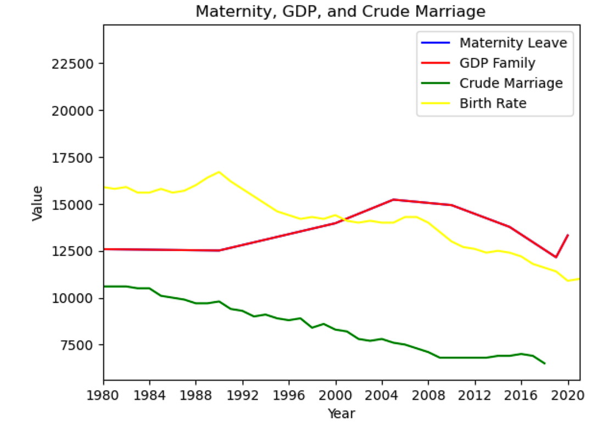

Family Influences
What's the relationship between birth rates and marriages?
The relationship between marriages and birth rate is both declining:
Birth rate seems to be lowering at a more rapid pace than marriage.
Why is this happening? …..New social changes
Perhaps because younger generations want to wait and have a career
Between birth rate and Family Benefit Spending of GDP?
GDP was consistent for ten years so did the birth rate and the marriage rate was slowly declining.
1990 had increase in spending for the Family Spending GDP
Same year the birth rate at peak declined rapidly!
After 1990 the marriage and birth rate did not find recovery.
We can see GPD increased from 1990 to 2004 then declined until Covid in 2020 when there was a spike to increase.
This did not affect the birth rate.

Slide 8

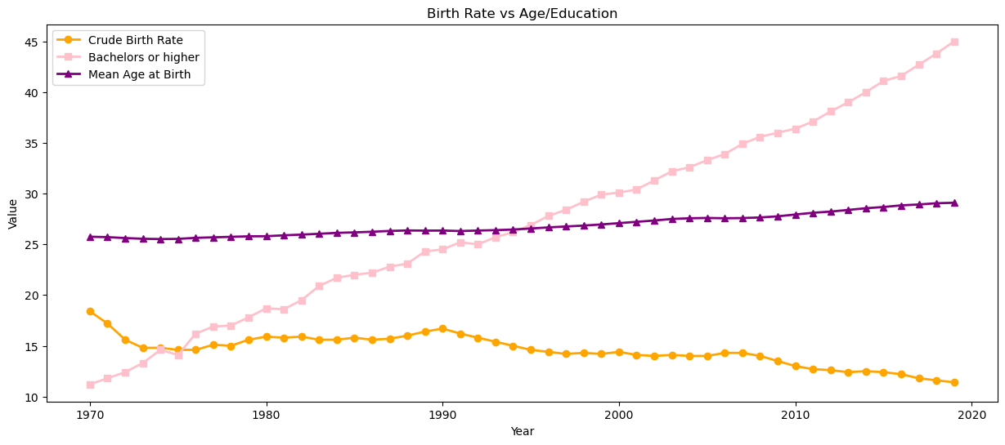
Female Education & Mean Birth Age
Birth rate and women who had a bachelor's degree and higher (r = -0.86), had a strong negative correlation.
A strong correlation of r = 0.98, between woman pursuing a bachelors degree or higher and the mean birth age.
Birth rate and women’s mean age when they gave birth (r = - 0.88), had a strong negative correlation.

Slide 9

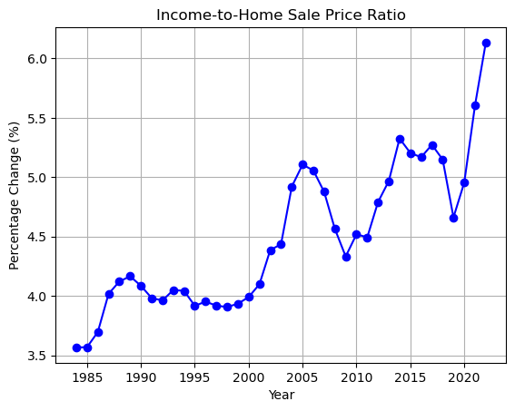
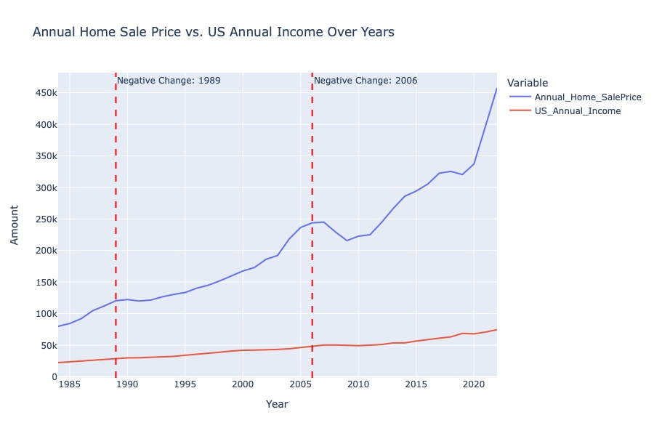
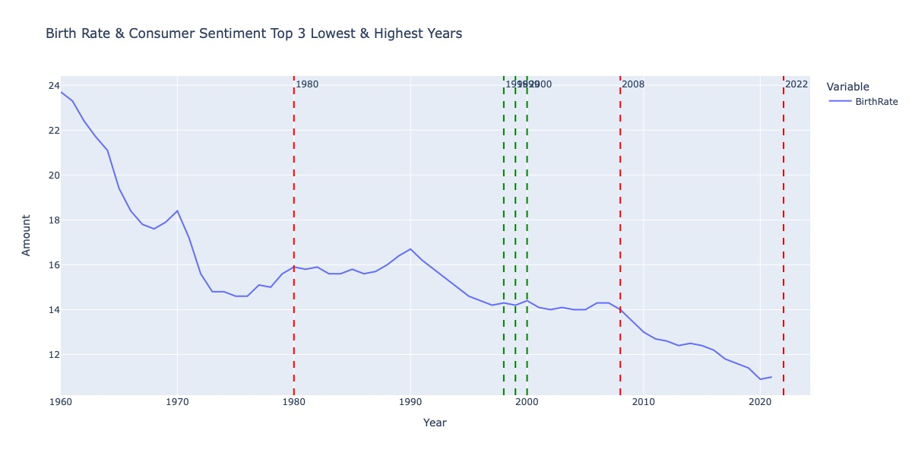
Economic & Sentiment
Income & Affordability:
U.S. Medium Home Sale Price & U.S. Medium Household Income was used to create a ratio by dividing the two amounts.
Results showed that unaffordability has been at its highest with the strongest acceleration occurring after 2020.
Birthrate and Annual_Income_25to34: -0.94 (p-value: 0.0000)
Birthrate and US_Annual_Income: -0.95 (p-value: 0.0000)
Birthrate and Annual_Home_SalePrice: -0.93 (p-value: 0.0000)
Price_to_Income_Ratio and Birthrate: -0.77 (p-value: 0.0000))
Consumer Sentiment & Birth Rate.
No relationship between consumer sentiment and Annual Income (25–34-year-olds), U.S. Annual Household Income, and Median Home Sale Price.
However, there was a relationship between consumer sentiment and the percentage change Year-over-Year change in Birth Rate.
Consumer Sentiment and Birth Rate % Change: 0.35 (p-value: 0.0328)

Slide 10
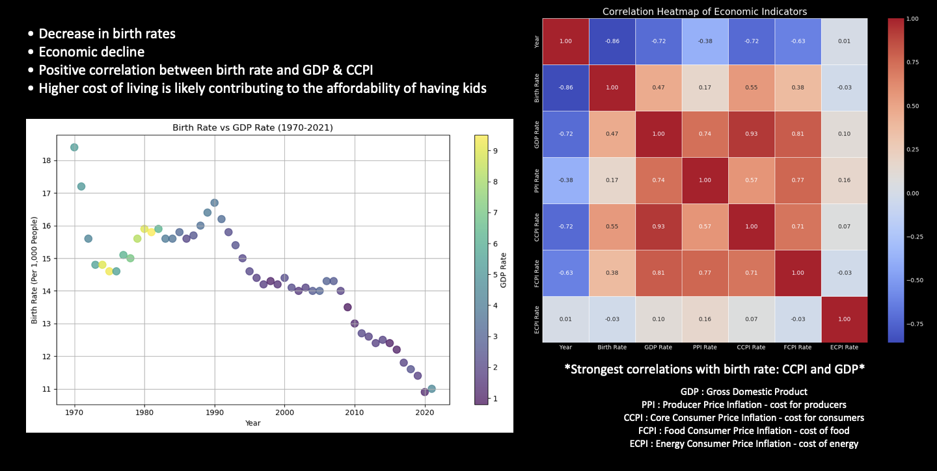
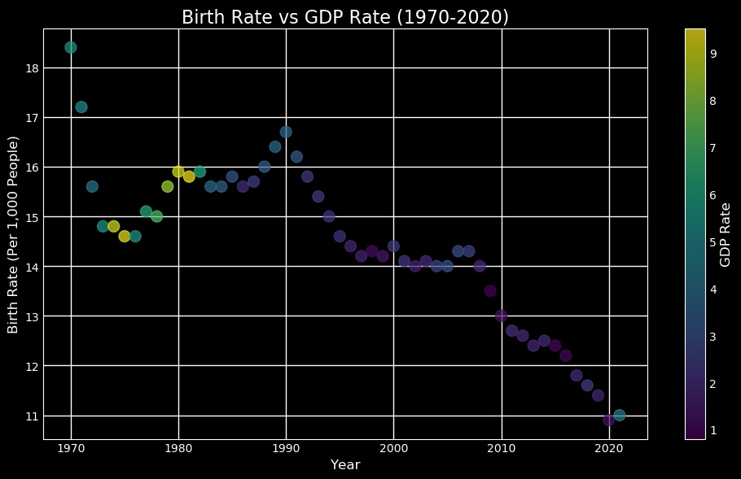
Micro/Macro Economic Impact

Slide 11



Conclusion & Future Research
We found the strongest correlation between birth rate and women pursuing higher education (r= 0.86), Annual Income 25 to 34 (r = -0.94) & Annual Home Sale Price (r = -0.93).
Conclusion:
Future Research:
We discovered many relationships in the economy, social, and education.
Conduct further research by including other countries. Assess whether countries that have provided more support to women have seen an improvement in Birth Rate.
Birth Rate has been declining for many years now without an improvement.
Working conditions should support both men and women better in order to increase family creation.
Businesses should provide same support to men in order to remove the responsibility of women being the main child support system.
There should be additional support to encourage people to build families.
Do your part in saving the country.

Slide 12

Thank You!

